Slide 1

CSE 163
Data Visualization
Hunter Schafer

Slide 2
Some Data
Can you tell me the relationship between x and y?
μ_{X} = 9.0 σ_{X} = 3.317 μ_{y} = 7.5 σ_{y} = 2.03
y = 3 + 0.5x R² = 0.67
I |  | II |  | III |  | IV
x | y | x | y | x | y | x | y
10.0 | 8.04 | 10.0 | 9.14 | 10.0 | 7.46 | 8.0 | 6.58
8.0 | 6.95 | 8.0 | 8.14 | 8.0 | 6.77 | 8.0 | 5.76
13.0 | 7.58 | 13.0 | 8.74 | 13.0 | 12.74 | 8.0 | 7.71
9.0 | 8.81 | 9.0 | 8.77 | 9.0 | 7.11 | 8.0 | 8.84
11.0 | 8.33 | 11.0 | 9.26 | 11.0 | 7.81 | 8.0 | 8.47
14.0 | 9.96 | 14.0 | 8.10 | 14.0 | 8.84 | 8.0 | 7.04
6.0 | 7.24 | 6.0 | 6.13 | 6.0 | 6.08 | 8.0 | 5.25
4.0 | 4.26 | 4.0 | 3.10 | 4.0 | 5.39 | 19.0 | 12.50
12.0 | 10.84 | 12.0 | 9.13 | 12.0 | 8.15 | 8.0 | 5.56
7.0 | 4.82 | 7.0 | 7.26 | 7.0 | 6.42 | 8.0 | 7.91
5.0 | 5.68 | 5.0 | 4.74 | 5.0 | 5.73 | 8.0 | 6.89
x | y
10.0 | 7.46
8.0 | 6.77
13.0 | 12.74
9.0 | 7.11
11.0 | 7.81
14.0 | 8.84
6.0 | 6.08
4.0 | 5.39
12.0 | 8.15
7.0 | 6.42
5.0 | 5.73
[Anscombe 73]

Slide 3
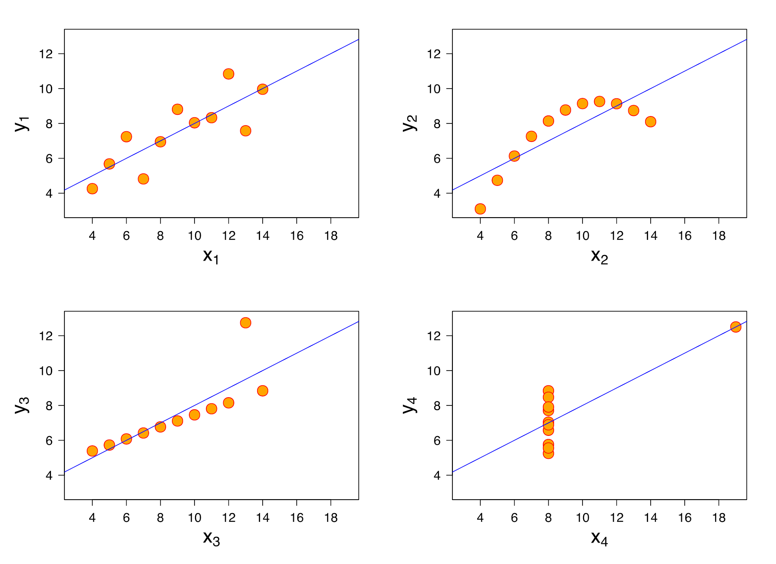
Some Data Visualizations

Slide 4
The Value of Visualization
Answer questions (or discover them)
Make decisions
See data in context
Find patterns
Present argument or tell a story
Inspire
Answer questions (or discover them)
Make decisions
See data in context
Find patterns
Present argument or tell a story
Inspire

Slide 5
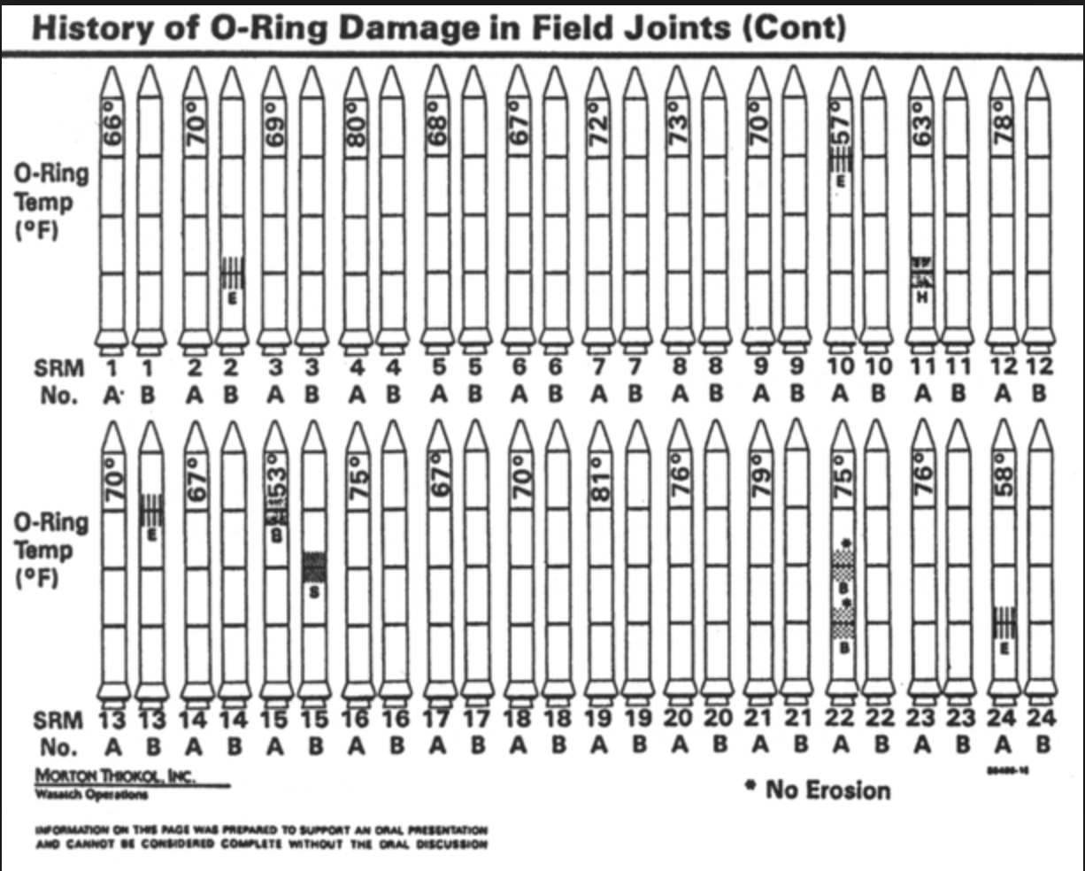
Make a Decision:
Challenger

Slide 6
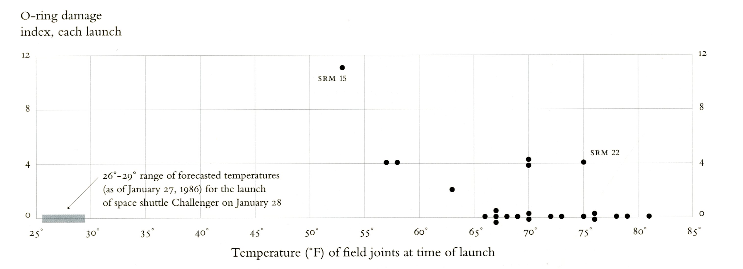
Make a Decision:
Challenger
Visualizations drawn by Tufte show how low temperatures damage O-rings [Tufte 97]

Slide 7
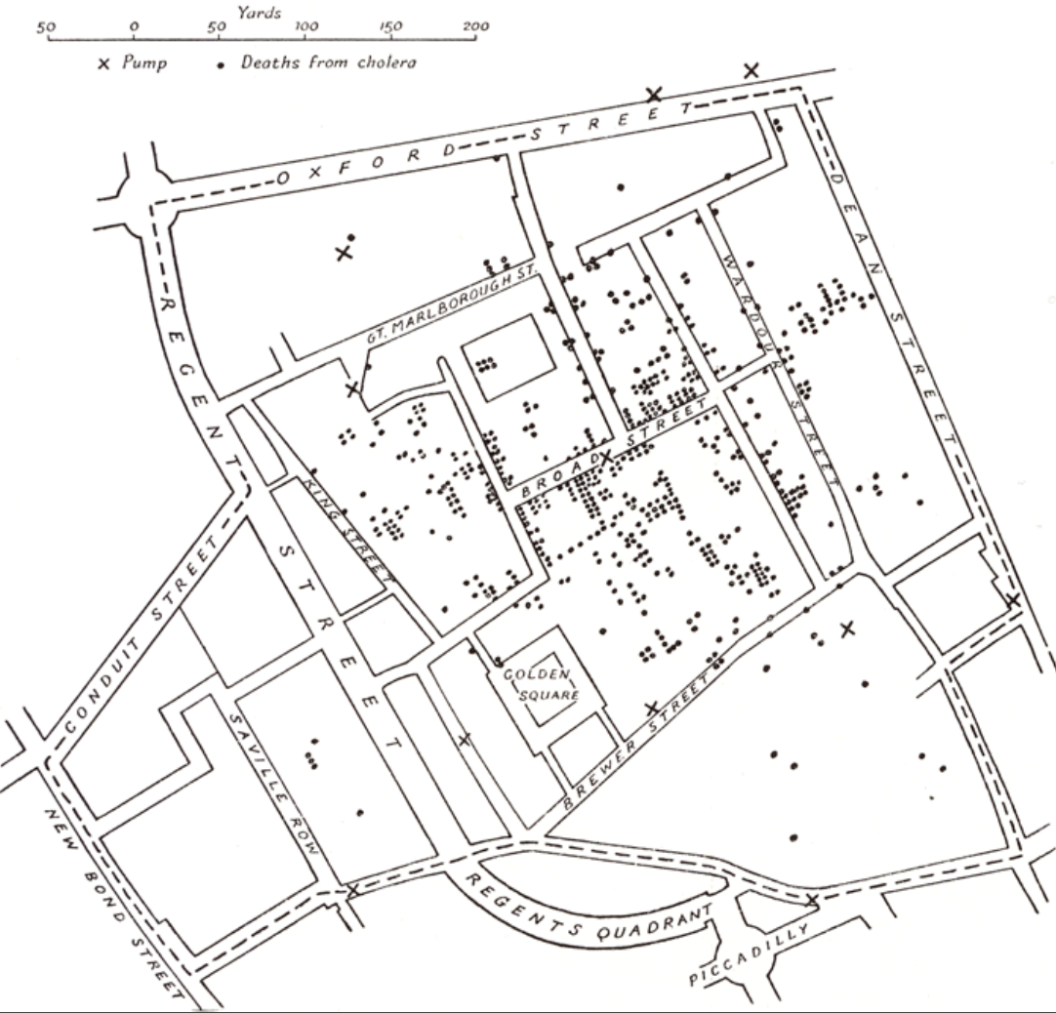
Data in Context:
Cholera Outbreak
In 1854 John Snow plotted the position of each cholera case on a map. [from Tufte 83]

Slide 8
Data in Context:
Cholera Outbreak
Used map to hypothesize that pump on Broad St. was the cause. [from Tufte 83]

Slide 9
Data Viz in Python
Many libraries exist to do graphics and plotting visualizations
The most popular two are
matplotlib: extremely customizable (to a fault)
seaborn: great out-of-the-box visualizations)
We will encourage using seaborn since it’s quickly becoming the standard for data scientists for most of their work
We still will rely on matplotlib for some things
You are welcome to use it more in depth on your project to make highly customized charts

Slide 10
Reading Documentation
Seaborn has excellent docs, great practice for reading!
How to read documentation
Skim examples, don’t focus too much on code
Read overview
Look at examples and the code. Look at documentation for relevant parameters
(Sometimes) Skim parameter list
Here are the seaborn functions you might use
Bar/Violin Plot
Plot a Distribution
Scatter/Line Plot
Linear Regression Plot
Compare Two Variables
Heatmap

Slide 11
Seaborn Demo
Demo
Working with a slightly different Pokemon dataset
Visualize various aspects of the data
We only show a couple examples, but your homework asks you to do more!
Remember to call sns.set()
Here are the seaborn functions you might use
Bar/Violin Plot
Plot a Distribution
Scatter/Line Plot
Linear Regression Plot
Compare Two Variables
Heatmap

Slide 12
Visual Design Principles
Use effective encodings
Avoid over-encoding
Focus on readability, not aesthetics
Avoid perceptual traps that can trick people in forming wrong conclusions
Rarely does a single visualization answer all questions. Instead, the ability to generate appropriate visualizations quickly is critical!

Slide 13
Types of Data
Quantitative (numeric measurement)
Examples
Salary
age
Ordinal (categorical, but there is an ordering)
Examples
First place, second place, third place
High School, Associates, Bachelors, …
Nominal (categorical, no ordering)
Examples
Type of Pokemon
School you attend

Slide 14
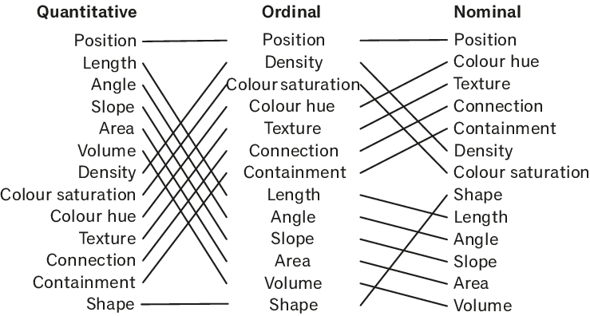
Encoding Effectiveness
[Mackinlay 86]

Slide 15
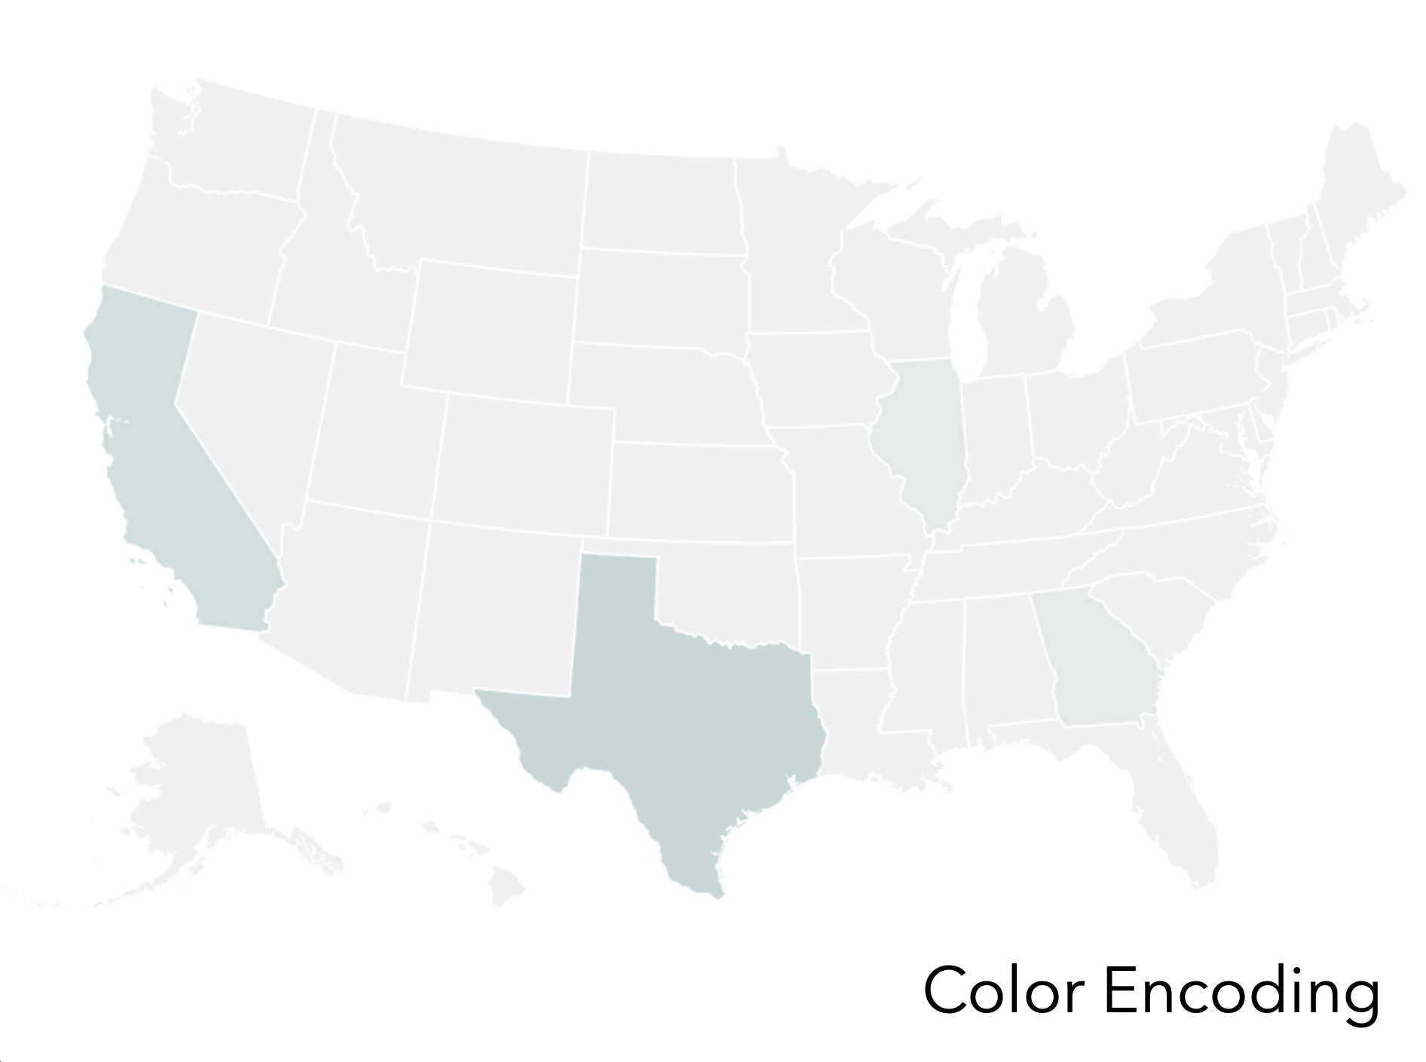
Example
Effectiveness

Slide 16
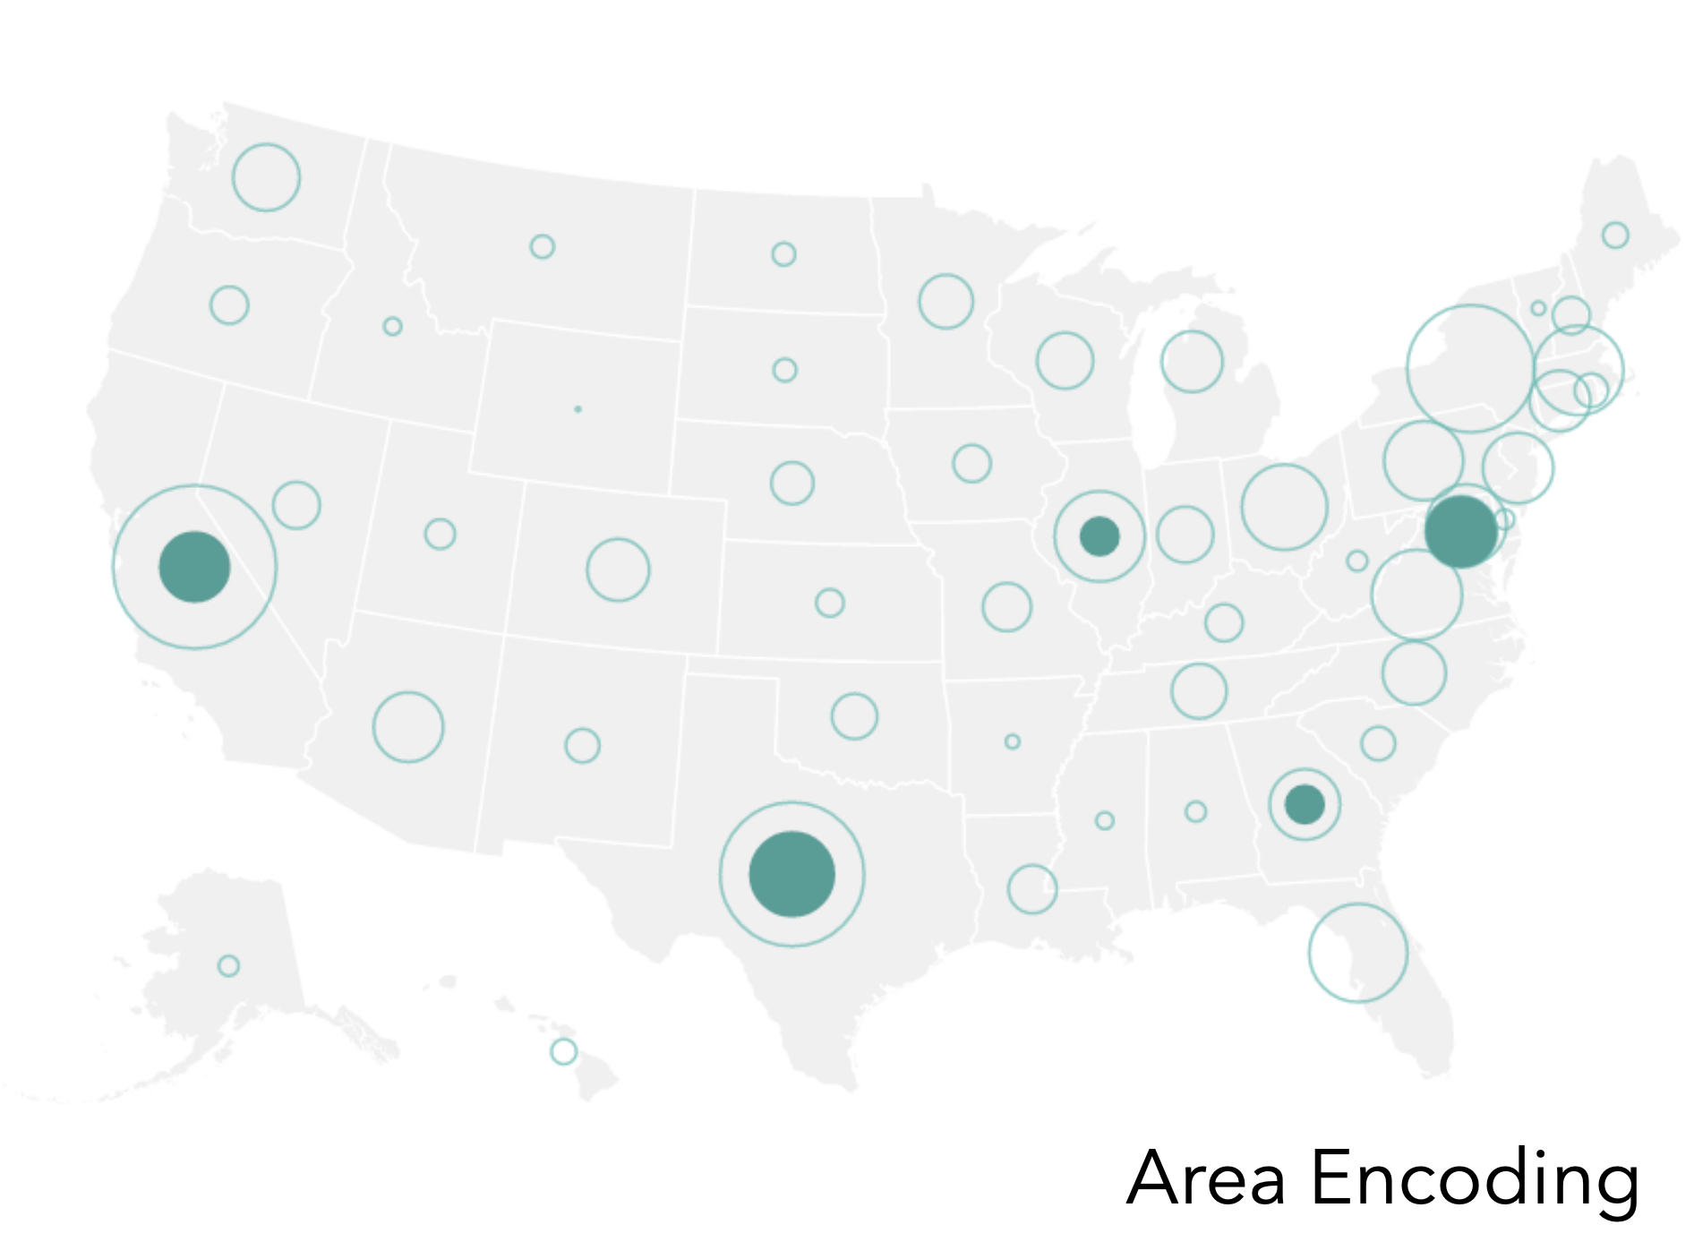
Example
Effectiveness

Slide 17
Encoding Effectiveness
[Mackinley 86]

Slide 18
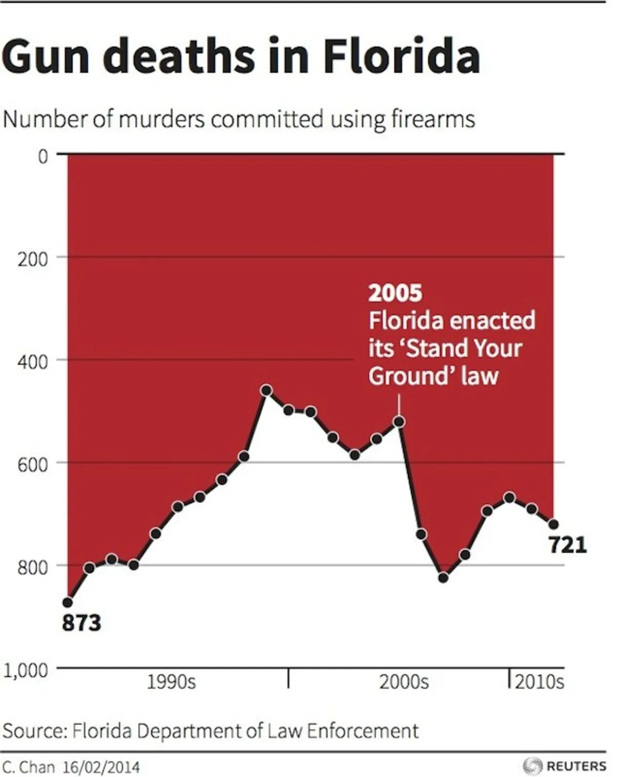
Readability

Slide 19
Did the number of gun deaths go up or down after the law was enacted?
Went up
Went down
About the same
Don’t remember
Yes, this was a real graphic posted in an article by Business Insider. They say it was made by Reuters.

Slide 20
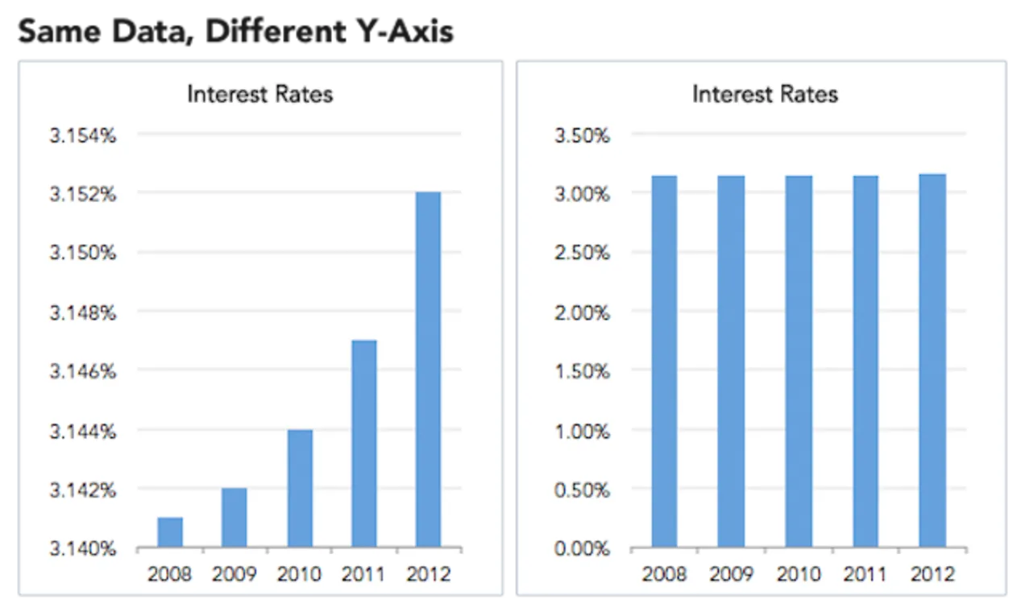
How to Lie with Data Viz

Slide 21
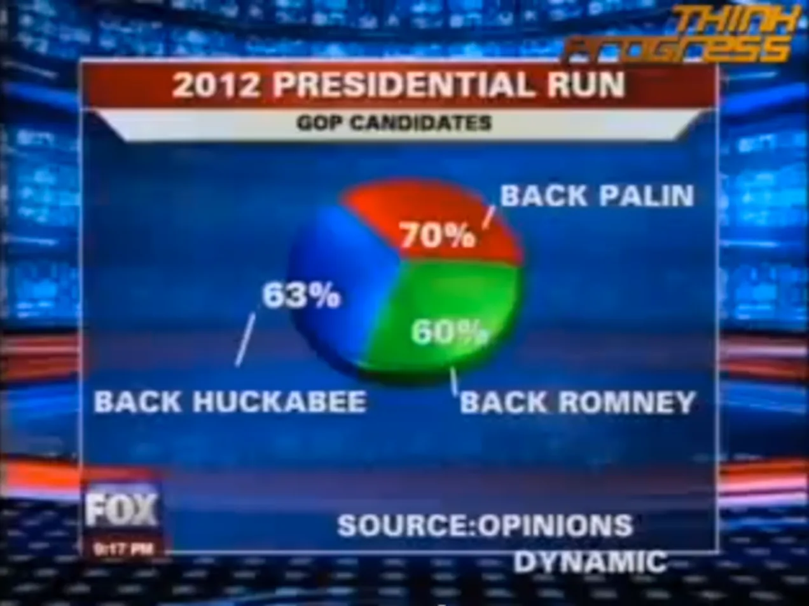
How to Lie with Data Viz

Slide 22
Seaborn
Demo
Sometimes the plots come out not looking great, you will probably need to figure out how to fix them to make them clearer
This can usually be solved by
Finding some more parameters in seaborn
Using matplotlib to save the day
You also generally use matplotlib to get your plots to appear or to save them to a file

Slide 23
Default Parameters
Python lets you define default values for parameters in case a client does not pass a specific value for that argument
def div(a=10, b=1):
return a / b
div(2, 3) # 0.66
div(2) # 2
div(b=3) # 3.33
div() # 10
This what allows libraries like seaborn or pandas to provide defaults!

